Slide 1
AI (Artificial Intelligence) & ML (Machine Learning) September 13, 2018

Slide 2
Welcome! 2018 Monthly Chapter Event
This Evening's Schedule
6:15 PM – 6:30 PM Networking and Refreshments
6:30 PM – 6:45 PM Chapter Business
6:45 PM – 7:30 PM Feature Presentation & Discussion
7:30 PM – 7:45 PM Q&A and Meeting Wrap Up

Slide 3
2018 Event Calendar
When: 2nd Thursday of Every Month
Where: Microsoft, Iselin, NJ
Upcoming Events
11-Oct-2018 An Microsoft Expert will provide a hands on demonstration on how to apply AI & ML using Microsoft business intelligence tools, such as Power BI, Visio and Excel
8-Nov-2018 Annual General Meeting
13-Dec-2018 Holiday Social

Slide 4
IIBA NJ
Recognized BA Experts
Community of BA Professionals
[Professional Network]
Center
Of
Excellence
[Prof. Development & Continuous Learning]
Thought Leaders in emerging technology & adjacent domains
BABOK / Certifications
IIBA
Notes:
Hedge hog effect – good to great

Slide 5
AI vs ML
AI: is the science of computers emulating humans (and sometimes dogs)
ML: is a method of how machines learn from data

Slide 6
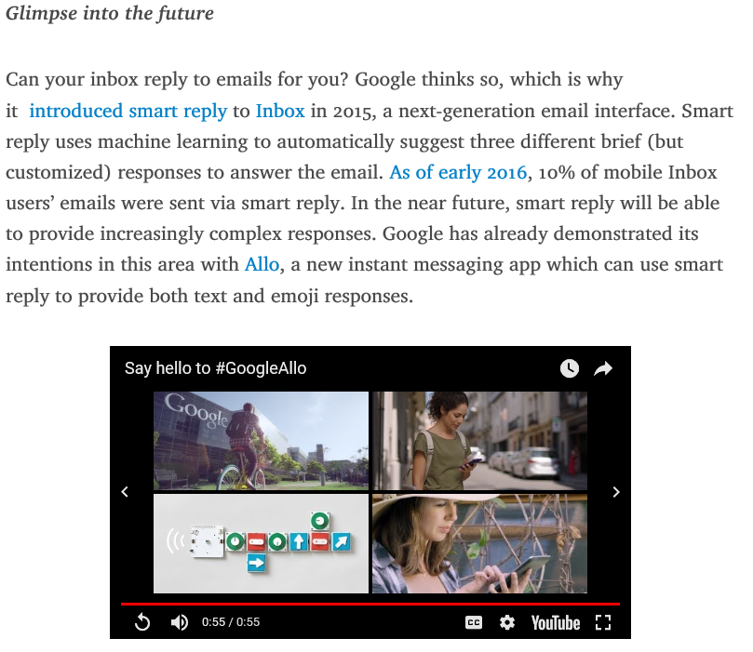
Everyday “Mainstream” Examples of AI
https://www.techemergence.com/everyday-examples-of-ai/
Email
Google’s Spam Filters
Gmail successfully filters 99.9% of spam.
Commuting
Waze
Google’s Smart Replay (GMAIL)

Slide 7
Video: Difference between AI & ML
Notes:
Video: 5:52

Slide 8
Video: New dog-like robot from Boston Dynamics can open doors

Slide 9
“Artificial intelligence is an entity (or collective set of cooperative entities), able to receive inputs from the environment, interpret and learn from such inputs, and exhibit related and flexible behaviors and actions that help the entity achieve a particular goal or objective over a period of time.”
researchers Shane Legg and Marcus Hutter
https://www.techemergence.com/what-is-artificial-intelligence-an-informed-definition/

Slide 10
Video: Google Duplex: A.I. Assistant Calls Local Businesses To Make Appointments

Slide 11
What is Machine Learning
“Machine Learning is the science of getting computers to learn and act like humans do, and improve their learning over time in autonomous fashion, by feeding them data and information in the form of observations and real-world interactions.”

Slide 12
Video: Yamaha MOTOBOT 2 vs. Valentino Rossi

Slide 13
What Kinds of Business Problems Can Machine Learning Handle
Is the prediction you’re trying to make (or decision you’re trying to make) complex enough to warrant ML in the first place?
Face detection
Email spam filters
Product / music / movie recommendation
Speech recognition
Credit card purchase fraud detection
Do you have new data and clean data?
Does your data have existing labels to help a machine make sense of it?
https://www.techemergence.com/how-to-apply-machine-learning-to-business-problems/

Slide 14
Amazon Go
How would you develop the requirements for this project?
https://www.amazon.com/b?ie=UTF8&node=16008589011

